Slide 1



AJIOD DJK Introduction to HTML
HTML, or Hypertext Markup Language, is the standard language used to create and structure the content of web pages. It provides a framework for presenting information in an organized and visually appealing way on the internet.
by Mohammad Javad Sharifi

Slide 2

What is HTML?
Definition
Purpose
Functionality
HTML is a markup language that defines the structure and layout of a web page, including headings, paragraphs, links, and images.
The primary purpose of HTML is to communicate the content and organization of a web page to web browsers, which then interpret the code and display the page accordingly.
HTML tags and elements work together to create the visual and interactive elements of a website, from basic text formatting to complex multimedia features.

Slide 3

HTML Structure
1
HTML Document
An HTML document consists of a series of elements, which are denoted by tags enclosed in angle brackets, such as <html>.
2
Head and Body
The <head> section contains metadata about the page, while the <body> section holds the visible content.
3
Nesting and Hierarchy
HTML elements can be nested within each other, creating a hierarchical structure that defines the relationships between different parts of the page.

Slide 4

HTML Elements
1
Semantic Elements
HTML provides a variety of semantic elements, such as <header>, <nav>, and <article>, which help convey the meaning and purpose of different parts of the page.
2
Formatting Elements
Elements like <h1> to <h6> for headings, <p> for paragraphs, and <em> and <strong> for emphasis allow for basic text formatting.
3
Multimedia Elements
HTML supports a variety of multimedia elements, including <img> for images, <video> for videos, and <audio> for audio clips.
4
Interactive Elements
Elements like <a> for links, <form> for user input, and <button> for interactive controls enable interactive features on web pages.

Slide 5




HTML Attributes
Attributes
Attributes provide additional information about HTML elements, such as the URL of a link or the size of an image.
Values
Attributes have values that specify the desired behavior or properties of an element, like the target of a link or the file source of an image.
Syntax
Attributes are added within the opening tag of an HTML element, with the attribute name followed by an equal sign and the attribute value in quotes.
Examples
Common attributes include src, href, class, and id, which are used to define image sources, link destinations, CSS classes, and unique identifiers, respectively.

Slide 6
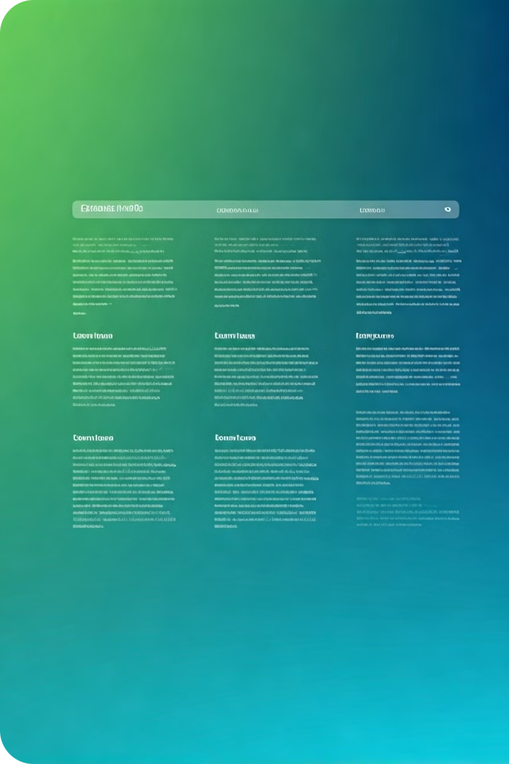

HTML Headings
Hierarchy
HTML provides six levels of headings, from <h1> to <h6>, which represent the structure and importance of content on a web page.
Semantics
Headings help search engines and assistive technologies understand the organization and meaning of a web page's content.
Styling
Headings can be styled using CSS to create visually appealing and consistent typography throughout a website.
Best Practices
Use headings in a logical order, with <h1> representing the main topic and lower-level headings for subtopics and sections.

Slide 7
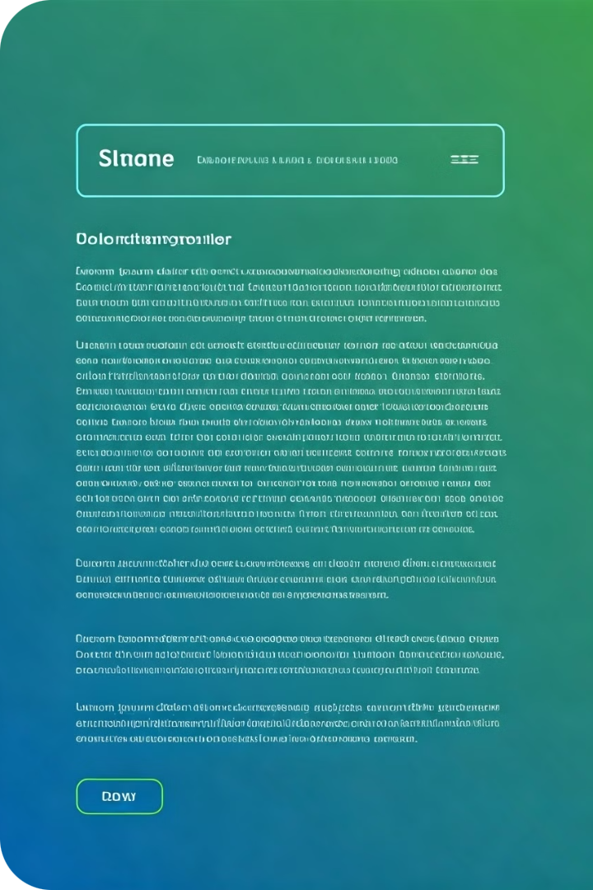



HTML Paragraphs
Structure
The <p> element is used to create paragraphs of text on a web page.
Formatting
Paragraphs can be further styled using CSS to control the appearance, such as font, size, and alignment.
Readability
Well-structured paragraphs with appropriate spacing and formatting can improve the overall readability and user experience of a web page.

Slide 8
HTML Links
Internal Links
External Links
Accessibility
The <a> element is used to create links between different pages or sections within a website, using the href attribute to specify the destination.
HTML links can also be used to connect a web page to external resources, such as other websites, documents, or media files, by providing a valid URL in the href attribute.
Providing clear and descriptive link text, as well as using the title attribute, can improve the accessibility of links for users with disabilities or screen readers.

Slide 9



HTML Images
Image Sources
Accessibility
Responsive Design
The <img> element is used to embed images on a web page, with the src attribute specifying the file path or URL of the image.
The alt attribute should be used to provide alternative text descriptions of images, which can be read by screen readers or displayed when the image cannot be loaded.
HTML images can be made responsive by using CSS to adjust their size and position based on the user's device and screen size.

Slide 10

Conclusion
HTML Fundamentals
HTML provides the basic structure and content for web pages, including headings, paragraphs, links, and images.
Semantic Markup
Proper use of HTML elements and attributes helps search engines and assistive technologies understand the meaning and purpose of web content.
Continuous Learning
As the web evolves, staying up-to-date with the latest HTML features and best practices is crucial for creating effective and accessible web experiences.

